Slide 1

Modelling Pitch Expectation in Melody: A Comparison of Variable-Order Markov and Transformer-Based Approaches
Ioannis Emmanouilidis
240955485
Notes:
Test

Slide 2
Background
Musical expectation has been experimentally verified to be a key mechanism lying behind music’s emotional power
Leonard Meyer’s hypothesis (1956): emotions arise from confirmation, violation, and delay of expectations
Decades of research to uncover the mental representations underpinning musical expectation and study the relationship between expectation and pleasure
Melodic expectation theories:
Innate Gestalt-rules (IR theory of Narmour, 1990)
Statistical learning posits that all patterns in expectation are learned from corpora. Shown to better explain melodic expectation in experiments
Deep neural models can model musical expectation (Music Transformer, PolyRNN)

Slide 3
Research Aim
Comparison of melodic pitch expectation abilities of IDyOM from Pearce (statistical learning) and Music Transformer from Huang et al. (deep learning)
Task: predict probe-tone ratings from behavioural experiments (previous comparison only on predicting neural responses by Kern et al., 2022)
Does one model better account for human ratings?
What can we learn about the representations that inform the Music Transformer’s predictions through this comparison?

Slide 4

IDyOM (Pearce, 2005)
Assumption: expectation stems from learned regularities in a musical corpus
It is a framework for constructing variable-order Markov models
LTM: internalises patterns from a training corpus
STM: picks up patterns from the piece in question up to the note we want to predict
Main intuition:
… weighed across LTM and STM, and also different viewpoints (pitch and onset related)

Slide 5
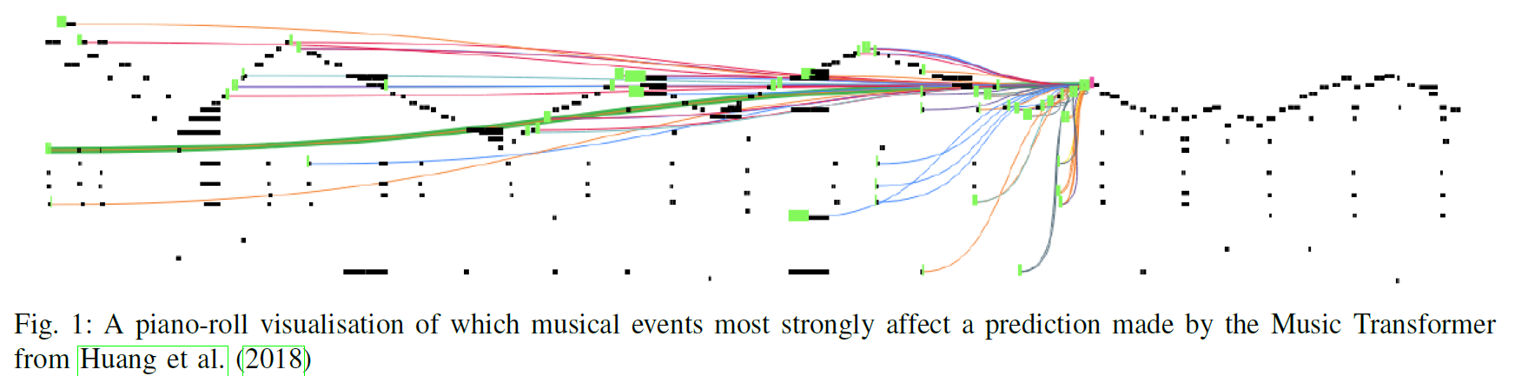
Music Transformer (Huang et al., 2018)
Adapted from original Transformer, Vaswani et al. (2017)
Key modification for music: use of relative self-attention (over self-attention). Domain motivation: in music, relative positions of events are important, not just absolute (e.g. rhythm augmentation)
Generative task: successful in generating plausible continuations from a musical stem, creates a probability distribution over all possible next events, given the context
Adaptation for musical expectation modelling: take this distribution as indicating expectation

Slide 6
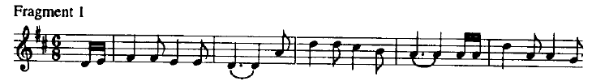
Datasets
Cuddy & Lunney (1995): 24 undergraduates (12 trained, 12 untrained)
8 different two-note contexts (plus inversions)
Participants rated possible continuations (25 chromatics tones) on a scale of 1-7
Schellenberg (1996): 20 participants
8 (tonal) folk fragments (16-21 notes long), 15 diatonic continuations
Same rating method

Slide 7

Method (IDyOM)
LTM was trained on monophonic corpus: 152 Canadian folk songs and ballads, 185 Bach chorale melodies, 566 German folk songs
Viewpoint selections:
- (cpitch)
- ((cpint cpintfref))
- (cpintfib cpintfip (cpint cpintfref) (cpitch ioi)) (optimal viewpoint)
Output: probability distribution for all MIDI notes at the probe position
Relevant probabilities for each experiment extracted, converted to Information Content (IC) for analysis

Slide 8
Method (Transformer)
Pretraining: MAESTRO dataset (150 epochs)
Fine-tuning: Monophonic Corpus of Complete Compositions (MCCC, 40 epochs).
Training parameters chosen to match with Kern et al. to aid comparison of findings
Stimuli encoding: tokens for NOTE_ON (pitch 0–127), NOTE_OFF, TIME_SHIFT, VELOCITY
Probability distributions generated for all pitch-related tokens based on left context
Again, relevant probability extraction and IC conversion

Slide 9
Statistical Analysis
1. OLS regression: model predictions (independent variable) vs human ratings (dependent variable)
2. Variance portioning to find the unique contributions of IDyOM and Transformer
3. Steiger’s test: determine if difference in correlations from regression were statistically significant

Slide 10
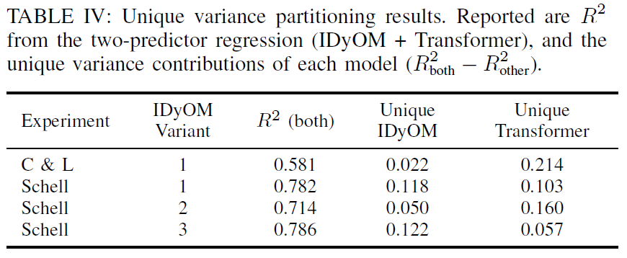
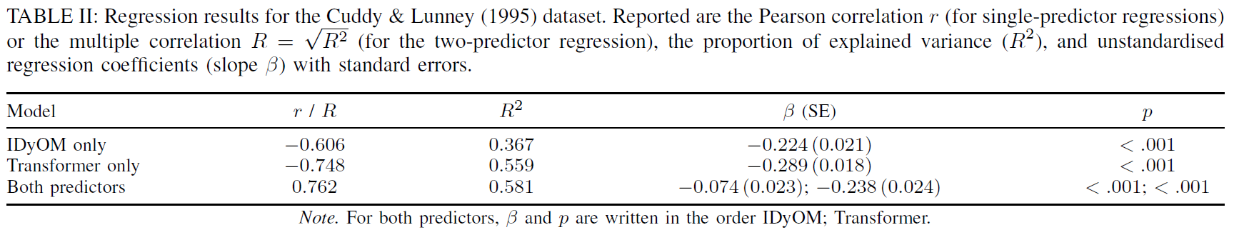
Results: Cuddy and Lunney
IDyOM: R² = 0.367, Transformer: R² = 0.559
Transformer uniquely explained 21% variance (beyond IDyOM)
Steiger’s test confirmed difference in correlations (r) to be statistically significant (p = 0.003)

Slide 11
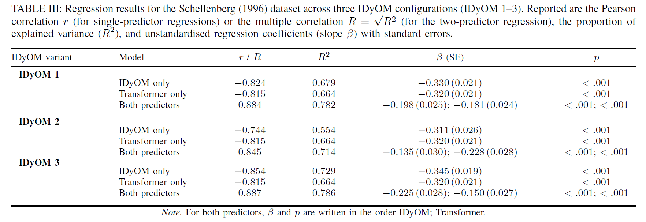
Results: Schellenberg
IDyOM: R² between 0.554 and 0.729 (depending on viewpoints used)
Transformer explained more unique variance than IDyOM 2, less than IDyOM 1 and IDyOM 3
Steiger’s test: no significant correlation difference between any of the IDyOM variants and the Transformer

Slide 12
Discussion
Transformer outperforms IDyOM for short contexts, where there are no higher-level representations due to context length (e.g. tonality). Somewhat limited theoretical significance
Models perform comparably in longer melodic contexts
Significant variance overlap -> both pick up on similar representations which are relevant to melodic expectation in humans
Comparing IDyOM (interpretable) with Music Transformer (more black box) makes Music Transformer more interpretable; e.g. high correlation between predictions of IDyOM 3 and Transformer -> Music Transformer uses information from attributes like interval from first note of bar/piece and iois for its predictions

Slide 13
Limitations and future work
Evaluation restricted to two behavioural datasets – extend to note-by-note experimental paradigms (e.g. predict Manzara data)
Training corpora differ between IDyOM and Transformer – fine-tune Transformer on “IDyOM corpus” (simulate common listening history)
Explore and isolate more IDyOM viewpoints (1. deeper insights into which musical representations are important in expectation; 2. improve Transformer explainability)
Polyphonic music (IDyOM can track simultaneous note events)
More naturalistic stimuli -> come closer to understanding the full spectrum of representations that are important in real-life music listening

